Slide 1

Introduction to Python
System Development and Design

Slide 2
Lecture Objectives
Introduce Python and its core features.
Differentiate between Python and C/C++.
Learn Python syntax fundamentals.
Comprehend memory management in Python.
Understand classes and encapsulation in Python.
Use modules and imports effectively.
Explore key data structures: lists, tuples, and dictionaries.
Apply list comprehensions for concise code.
Master dictionary operations: creation, manipulation, and iteration.

Slide 3
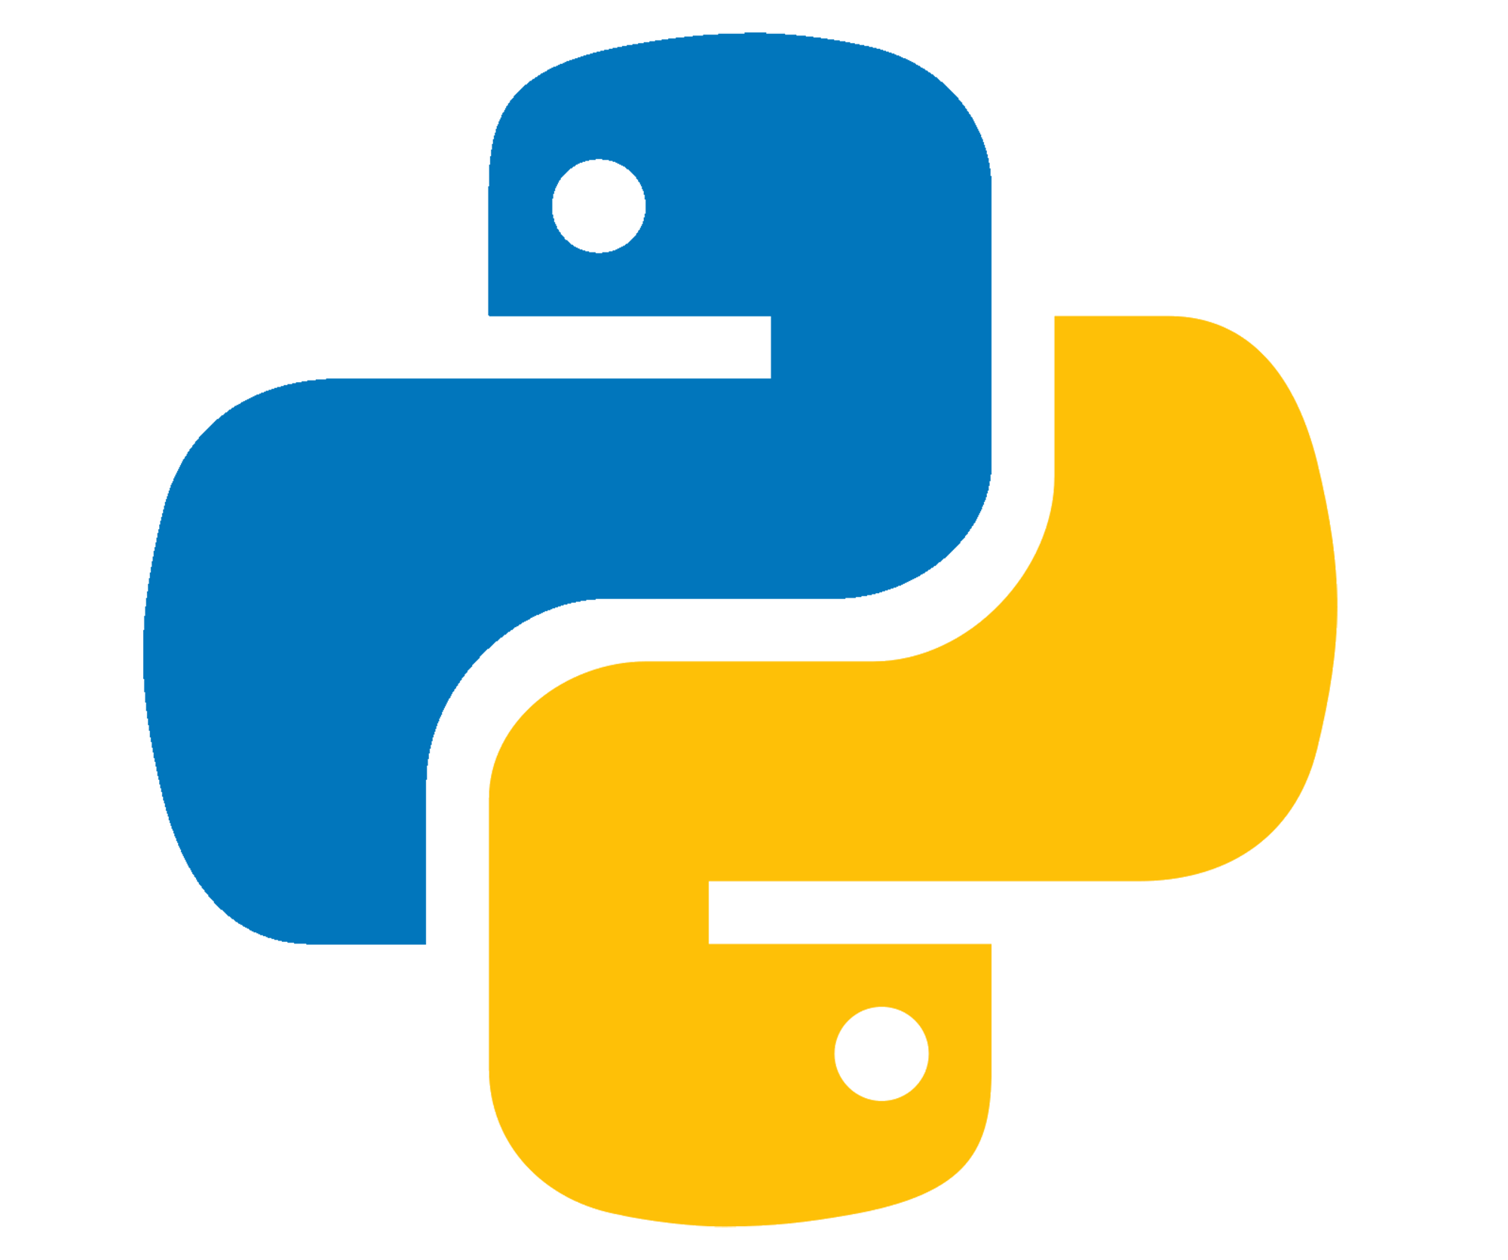
What is Python?
Python is a high-level, interpreted programming language.
Known for its simplicity and readability.
Used in web development, data science, AI, and more.

Slide 4
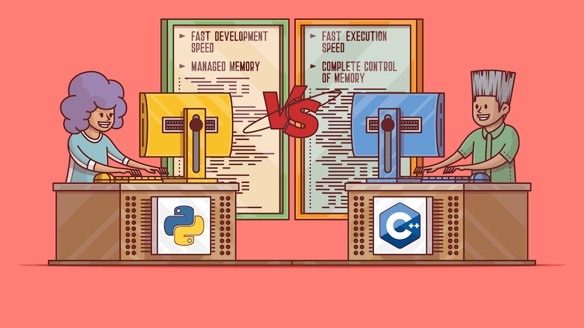
Python vs C/C++
Python:
Interpreted language (runs directly).
Dynamic typing (no need to declare types).
Automatic memory management (garbage collection).

Slide 5
Python vs C/C++
C/C++:
Compiled language (needs a compiler).
Static typing (types declared explicitly).
Manual memory management.

Slide 6
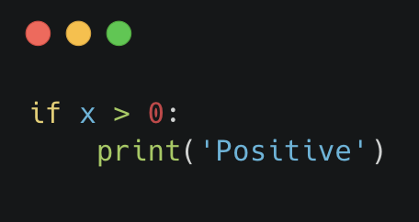
Python Syntax Basics
Indentation is used to define blocks:
No semicolons or braces are needed.

Slide 7
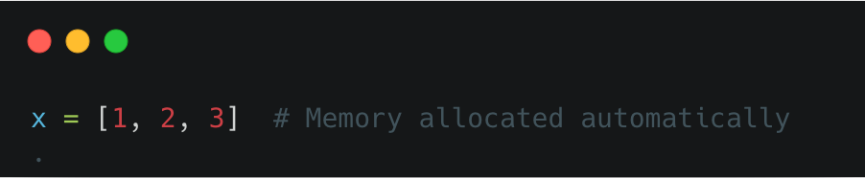
Memory Management
Python uses automatic garbage collection.
No need to manage memory manually, unlike in C++.
Example:

Slide 8
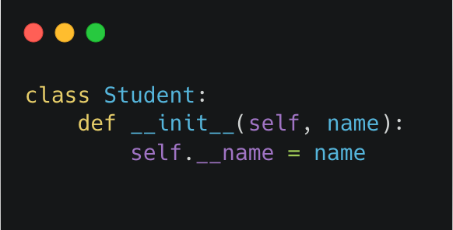
Classes and Encapsulation
Class Example:
Private variables use double underscores (__).

Slide 9
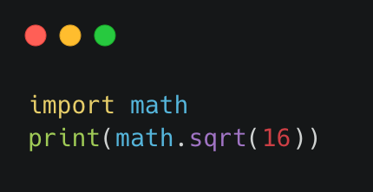
Modules and Imports
Modules help organize code.
Example:

Slide 10
Python Data Structures
Lists: Ordered, mutable collections.
Example: [1, 2, 3]
Tuples: Ordered, immutable collections.
Example: (1, 2, 3)
Dictionaries: Key-value pairs.
Example: {'name': 'Alice', 'age': 25}

Slide 11
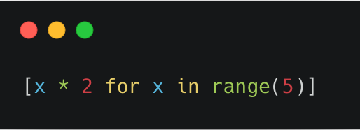
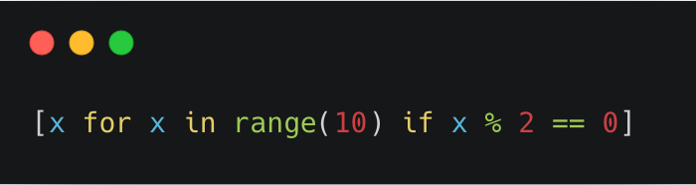
List Comprehensions
Generate a list with a single line:
Example:
Add conditions:
Example:

Slide 12
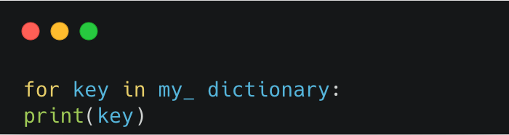
Dictionaries
Key-value pairs:
Example: {'key': 'value’}
Accessing values:
Example: my_dictionary['key']
Iterating through keys:
Example:

Slide 13
Conclusion
Python is a high-level, versatile programming language known for simplicity, readability, and wide applicability in fields like web development, data science, and AI.
Its interpreted nature, dynamic typing, and automatic memory management make it efficient and beginner-friendly.
Unlike C/C++, Python eliminates the need for manual memory management and uses indentation instead of braces for code structuring.
Python supports object-oriented programming with features like classes and encapsulation, enabling clean and modular code.
It offers robust built-in data structures, including lists, tuples, and dictionaries, allowing for efficient data management and manipulation.
Features like list comprehensions and dictionary operations promote concise and expressive code.
Modular programming is streamlined with Python’s import functionality, facilitating code organization and reusability.

Slide 14
Questions?

